Slide 1
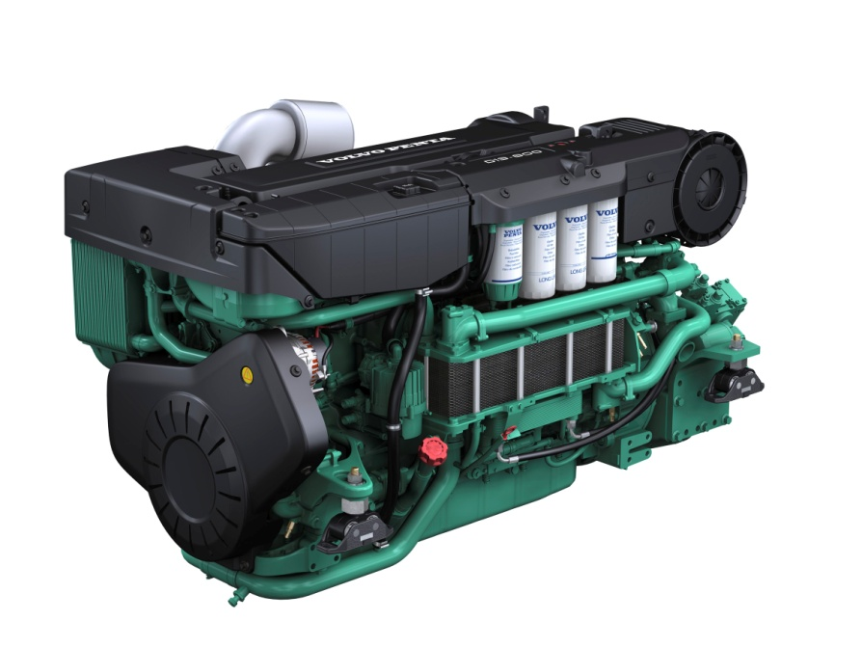
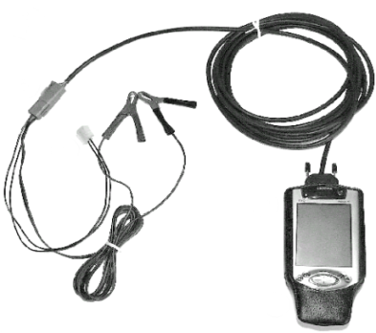


Certificate
This certifies that
Choi Je Guen
has satisfactorily completed the training
Product Training D13 Marine & EVC ‘s
21 – 25 Jan -2013
Volvo East Asia (Pte) Ltd
Volvo Penta Div.
Mazlan Onn
Trainer

Slide 2
Certificate
This certifies that
Son Sung Yong
has satisfactorily completed the training
Product Training D13 Marine & EVC ‘s
21 – 25 Jan -2013
Volvo East Asia (Pte) Ltd
Volvo Penta Div.
Mazlan Onn
Trainer

Slide 3
Certificate
This certifies that
Kim Hyun Hong
has satisfactorily completed the training
Product Training D13 Marine & EVC ‘s
21 – 25 Jan -2013
Volvo East Asia (Pte) Ltd
Volvo Penta Div.
Mazlan Onn
Trainer

Slide 4
Certificate
This certifies that
An Soon Tae
has satisfactorily completed the training
Product Training D13 Marine & EVC ‘s
21 – 25 Jan -2013
Volvo East Asia (Pte) Ltd
Volvo Penta Div.
Mazlan Onn
Trainer

Slide 5
Certificate
This certifies that
Son Chang Sik
has satisfactorily completed the training
Product Training D13 Marine & EVC ‘s
21 – 25 Jan -2013
Volvo East Asia (Pte) Ltd
Volvo Penta Div.
Mazlan Onn
Trainer

Slide 6
Certificate
This certifies that
Lim Yoon Ja
has satisfactorily completed the training
Product Training D13 Marine & EVC ‘s
21 – 25 Jan -2013
Volvo East Asia (Pte) Ltd
Volvo Penta Div.
Mazlan Onn
Trainer

Slide 7
Certificate
This certifies that
Lee Se Hyung
has satisfactorily completed the training
Product Training D13 Marine & EVC ‘s
21 – 25 Jan -2013
Volvo East Asia (Pte) Ltd
Volvo Penta Div.
Mazlan Onn
Trainer

Slide 8
Certificate
This certifies that
Lee Young Gon
has satisfactorily completed the training
Product Training D13 Marine & EVC ‘s
21 – 25 Jan -2013
Volvo East Asia (Pte) Ltd
Volvo Penta Div.
Mazlan Onn
Trainer

Slide 9
Certificate
This certifies that
Um Je Wook
has satisfactorily completed the training
Product Training D13 Marine & EVC ‘s
21 – 25 Jan -2013
Volvo East Asia (Pte) Ltd
Volvo Penta Div.
Mazlan Onn
Trainer

Slide 10
Certificate
This certifies that
Kim Sang Woo
has satisfactorily completed the training
Product Training D13 Marine & EVC ‘s
21 – 25 Jan -2013
Volvo East Asia (Pte) Ltd
Volvo Penta Div.
Mazlan Onn
Trainer

Slide 11
Certificate
This certifies that
Park Chun Guen
has satisfactorily completed the training
Product Training D13 Marine & EVC ‘s
21 – 25 Jan -2013
Volvo East Asia (Pte) Ltd
Volvo Penta Div.
Mazlan Onn
Trainer

Slide 12
Certificate
This certifies that
Cha Ki Young
has satisfactorily completed the training
Product Training D13 Marine & EVC ‘s
21 – 25 Jan -2013
Volvo East Asia (Pte) Ltd
Volvo Penta Div.
Mazlan Onn
Trainer

Slide 13
Certificate
This certifies that
Ko Dea Sik
has satisfactorily completed the training
Product Training D13 Marine & EVC ‘s
21 – 25 Jan -2013
Volvo East Asia (Pte) Ltd
Volvo Penta Div.
Mazlan Onn
Trainer

Slide 14
Certificate
This certifies that
Bang Yoon Guen
has satisfactorily completed the training
Product Training D13 Marine & EVC ‘s
21 – 25 Jan -2013
Volvo East Asia (Pte) Ltd
Volvo Penta Div.
Mazlan Onn
Trainer

Slide 15
Certificate
This certifies that
Yoon Soo Jin
has satisfactorily completed the training
Product Training D13 Marine & EVC ‘s
21 – 25 Jan -2013
Volvo East Asia (Pte) Ltd
Volvo Penta Div.
Mazlan Onn
Trainer

Slide 16
Certificate
This certifies that
Jeon Yong Hak
has satisfactorily completed the training
Product Training D13 Marine & EVC ‘s
21 – 25 Jan -2013
Volvo East Asia (Pte) Ltd
Volvo Penta Div.
Mazlan Onn
Trainer

Slide 17
Certificate
This certifies that
Lee Won Pyo
has satisfactorily completed the training
Product Training D13 Marine & EVC ‘s
21 – 25 Jan -2013
Volvo East Asia (Pte) Ltd
Volvo Penta Div.
Mazlan Onn
Trainer

Slide 18
Certificate
This certifies that
Park Min
has satisfactorily completed the training
Product Training D13 Marine & EVC ‘s
21 – 25 Jan -2013
Volvo East Asia (Pte) Ltd
Volvo Penta Div.
Mazlan Onn
Trainer

Slide 19
Certificate
This certifies that
Cho Hang Joon
has satisfactorily completed the training
Product Training D13 Marine & EVC ‘s
21 – 25 Jan -2013
Volvo East Asia (Pte) Ltd
Volvo Penta Div.
Mazlan Onn
Trainer

Slide 20
Certificate
This certifies that
Kim Young Soo
has satisfactorily completed the training
Product Training D13 Marine & EVC ‘s
21 – 25 Jan -2013
Volvo East Asia (Pte) Ltd
Volvo Penta Div.
Mazlan Onn
Trainer

Slide 21
Certificate
This certifies that
Lee Jae Sun
has satisfactorily completed the training
Product Training D13 Marine & EVC ‘s
21 – 25 Jan -2013
Volvo East Asia (Pte) Ltd
Volvo Penta Div.
Mazlan Onn
Trainer

Slide 22
Certificate
This certifies that
Kim Eun Sik
has satisfactorily completed the training
Product Training D13 Marine & EVC ‘s
21 – 25 Jan -2013
Volvo East Asia (Pte) Ltd
Volvo Penta Div.
Mazlan Onn
Trainer

Slide 23
Certificate
This certifies that
Kwon Young Hwa
has satisfactorily completed the training
Product Training D13 Marine & EVC ‘s
21 – 25 Jan -2013
Volvo East Asia (Pte) Ltd
Volvo Penta Div.
Mazlan Onn
Trainer

Slide 24
Certificate
This certifies that
Kim Dong Gil
has satisfactorily completed the training
Product Training D13 Marine & EVC ‘s
21 – 25 Jan -2013
Volvo East Asia (Pte) Ltd
Volvo Penta Div.
Mazlan Onn
Trainer

Slide 25
Certificate
This certifies that
Park Soon Bae
has satisfactorily completed the training
Product Training D13 Marine & EVC ‘s
21 – 25 Jan -2013
Volvo East Asia (Pte) Ltd
Volvo Penta Div.
Mazlan Onn
Trainer

Slide 26
Certificate
This certifies that
Yoon Gwang Yul
has satisfactorily completed the training
Product Training D13 Marine & EVC ‘s
21 – 25 Jan -2013
Volvo East Asia (Pte) Ltd
Volvo Penta Div.
Mazlan Onn
Trainer

Slide 27
Certificate
This certifies that
Lee Jin Uk
has satisfactorily completed the training
Product Training D13 Marine & EVC ‘s
21 – 25 Jan -2013
Volvo East Asia (Pte) Ltd
Volvo Penta Div.
Mazlan Onn
Trainer

